Slide 1
Projection Mapping with TouchDesigner
David Meredith
dave@create.aau.dk

Slide 2
Sources
https://derivative.ca/feature/projection-mapping/14
https://docs.derivative.ca/Palette:camSchnappr
https://www.youtube.com/watch?v=1QyFy6aJM4U

Slide 3
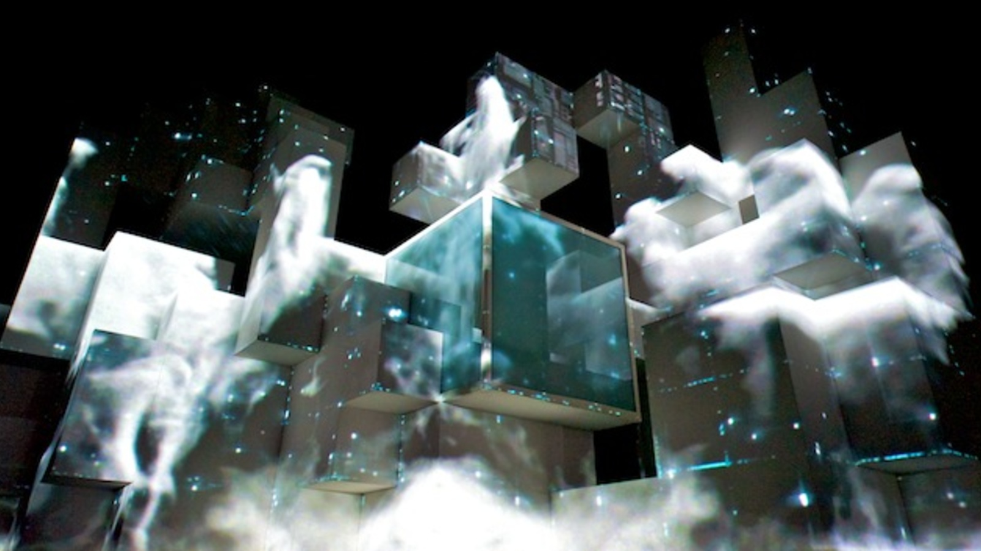
Projection Mapping
Projection mapping involves building a custom solution to each new job – no two projection setups are the same
TouchDesigner has a number of features and tools that make any projection project possible
Offers multiple approaches to tackle projection projects, depending on scenario and budget

Slide 4
Projection Mapping
You can use the “Stoner” tool for shaping your output with keystones and grid-type mesh warping
“ProjectorBlend” tool handles project blending and initial project setup

Slide 5
2D Projection Mapping
“Kantan Mapper” tool for 2D projection mapping and masking – lets you create polygons and bezier layer shapes to apply any image, movie or texture to map and mask anything your project hits with light
Shaping the output further with keystone and warping tools can also be applied per layer

Slide 6
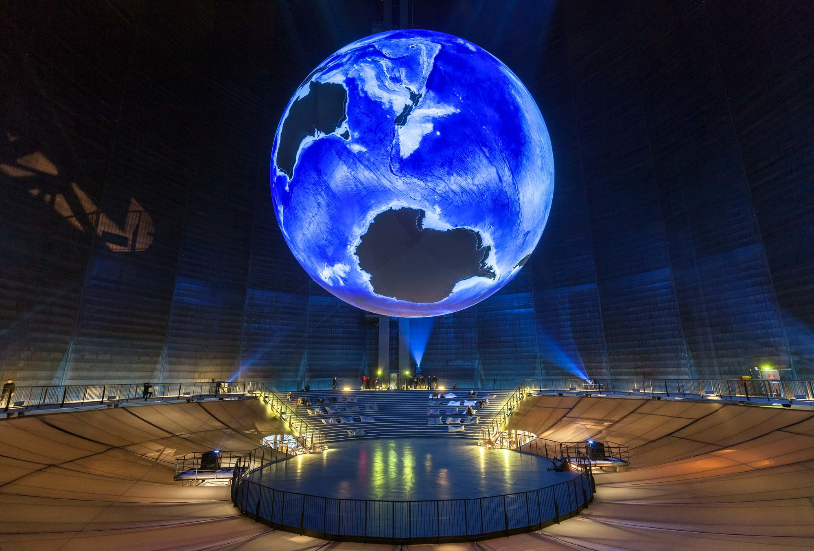
3D Projection Mapping
3D projection mapping is more complex than 2D
Use the ”Camschnappr” tool for 3D mapping
Given a 3D model of the object onto which you are projecting, line up 6 points with the Camschnappr interface and calculate the position of the project automatically adjusting the output to fit the 3D shape
For large and complex mapping scenes, TD also has native support for 3rd party mapping solutions like Vioso and Scalable Displays software

Slide 7
Summary of TD Features for Projection Mapping
Tight integration with the real-time 3D engine allows for complete pre-visualization of projection setups
Support for a wide variety of projection formats for mapping, dome, VR, stitching, and environment lights.
"Stoner" tool for keystoning, grid mesh warping, and masking.
"Kantan Mapper" tool for advanced 2D mapping and masking including freeform and bezier shapes.
"Camschnappr" tool for 3D model based projection alignment and calibration.
"SweetSpot" tool for trompe l'oeil effects that create an optical illusion of 3D from a 2D output.
Support for 3rd party solutions like Scalable Display's and Vioso's automatic mapping calibration tools.

Slide 8
Set up your objects and your projector
Set up the object that you want to project onto
Set up your projector so that it brightly illuminates the object from the perspective that you want people to view the object from

Slide 9
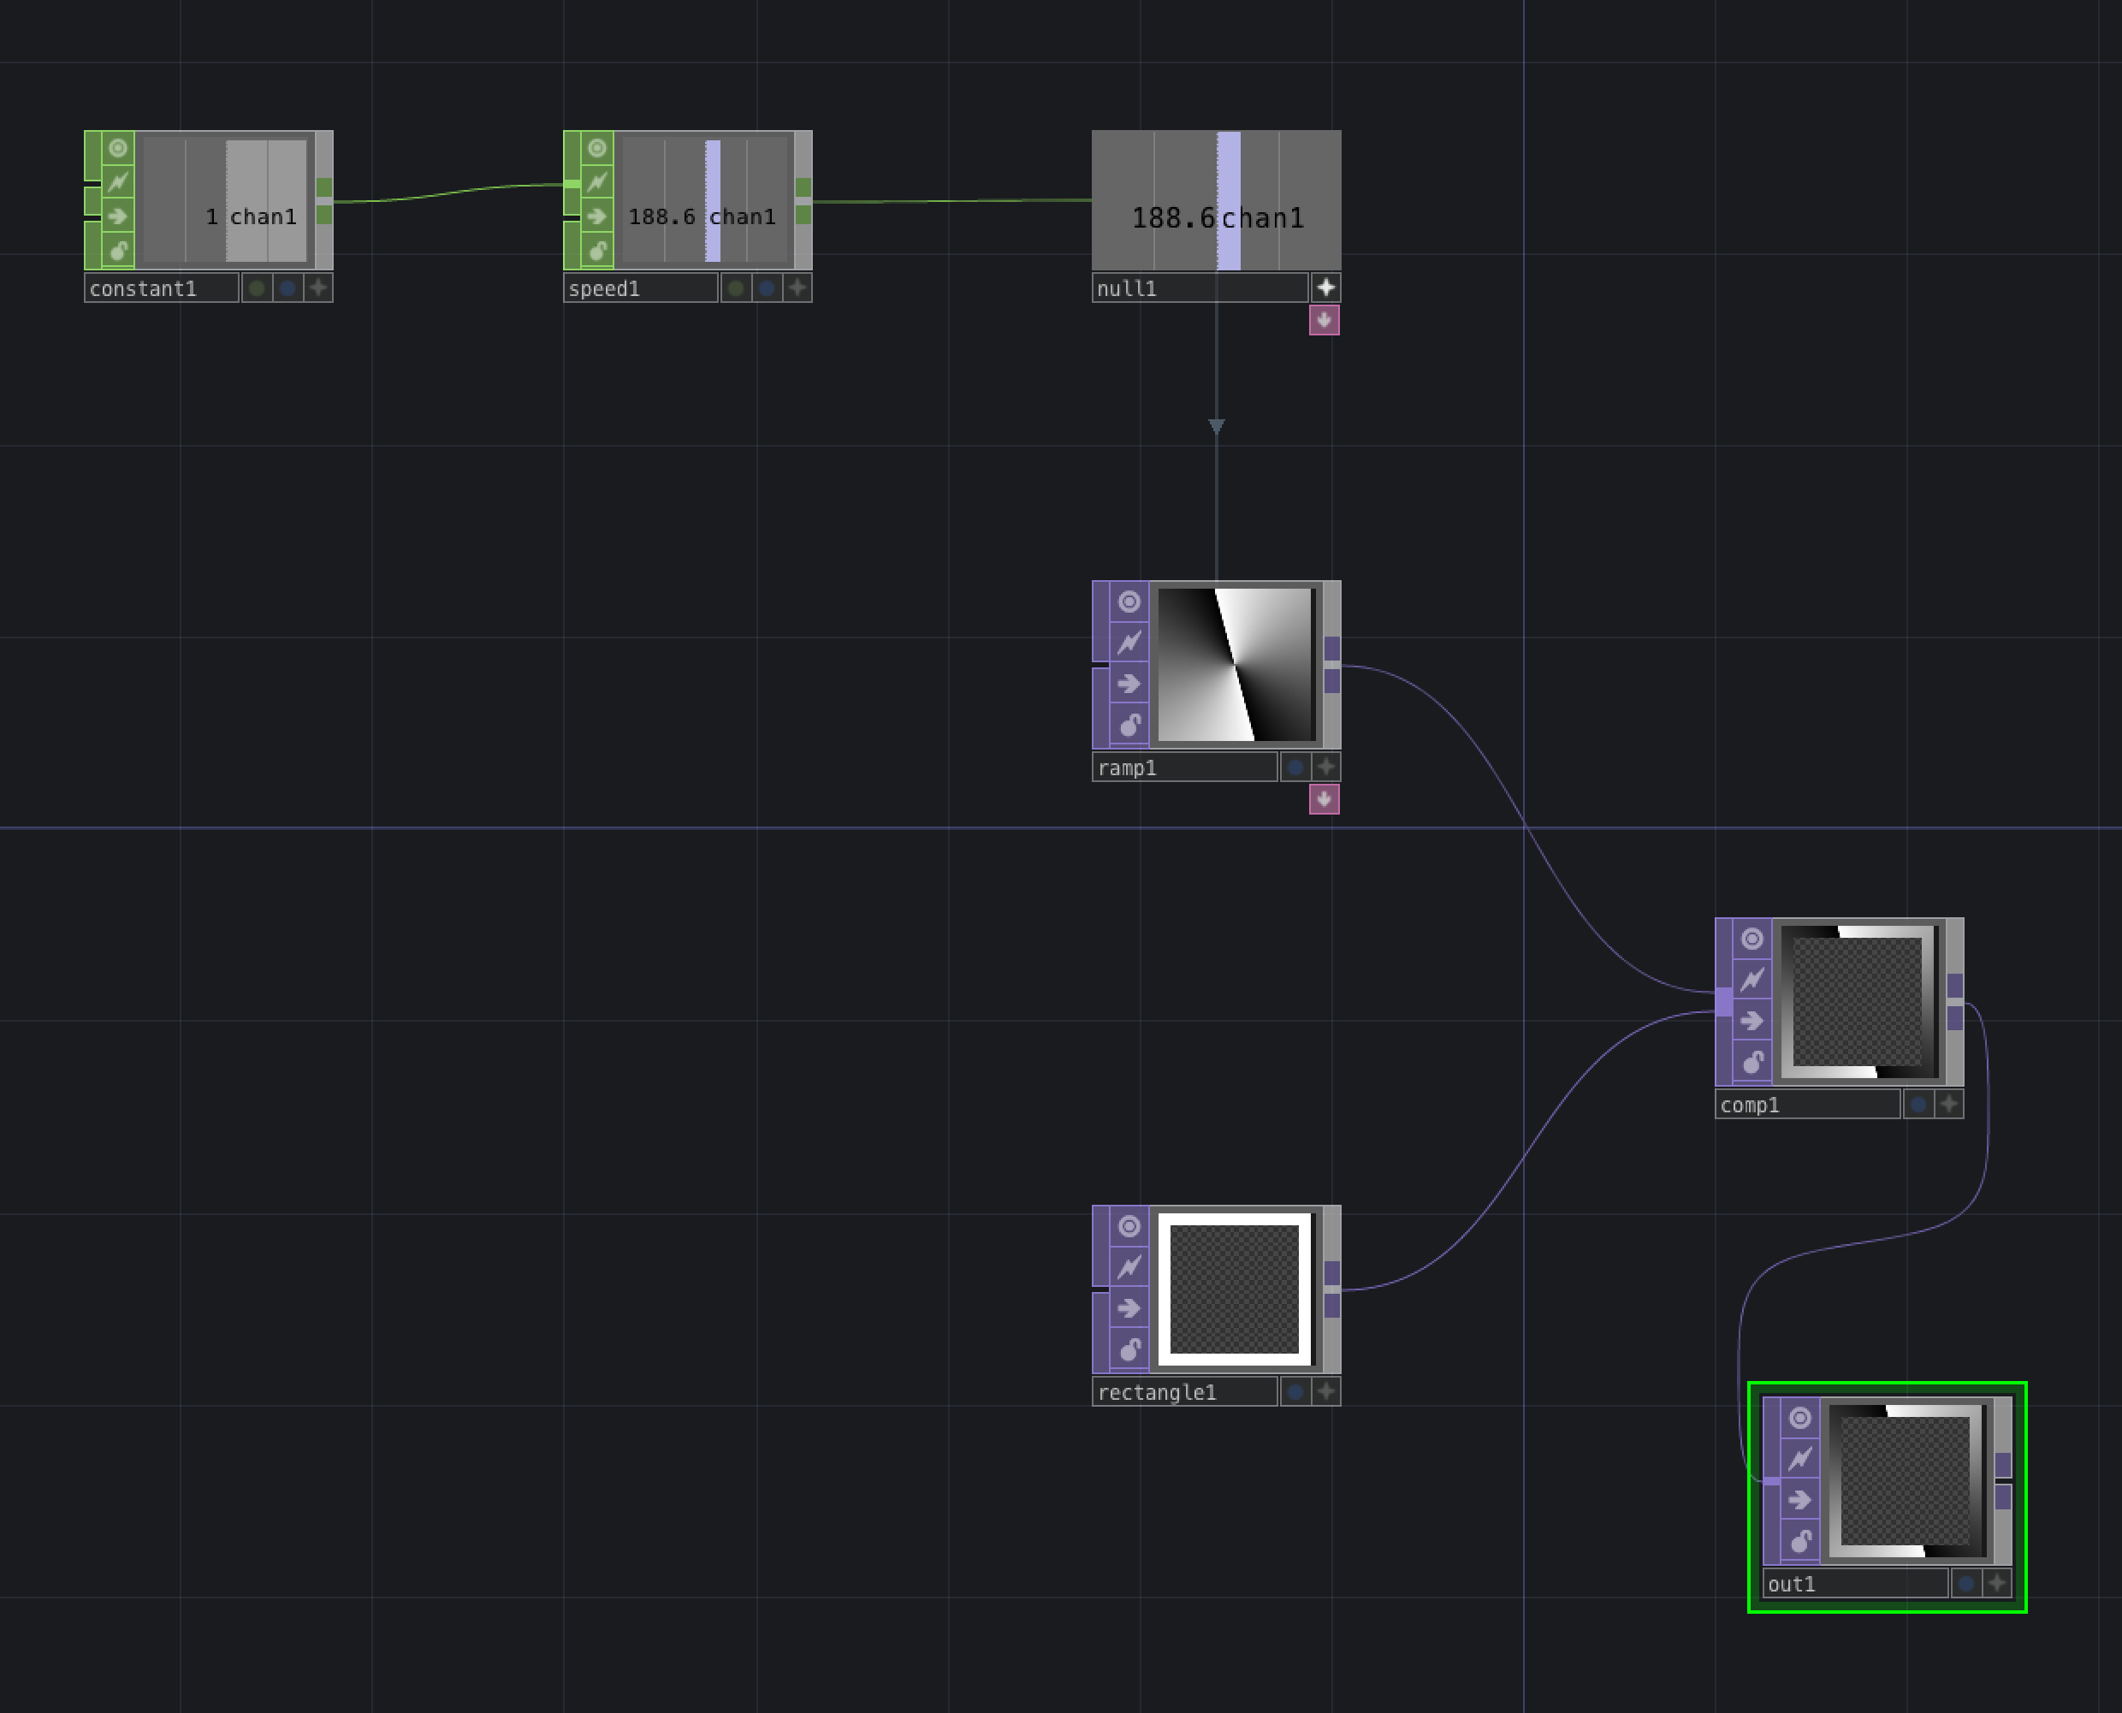
Create some content
Create a Container Component to hold some content and call it “content”

Slide 10
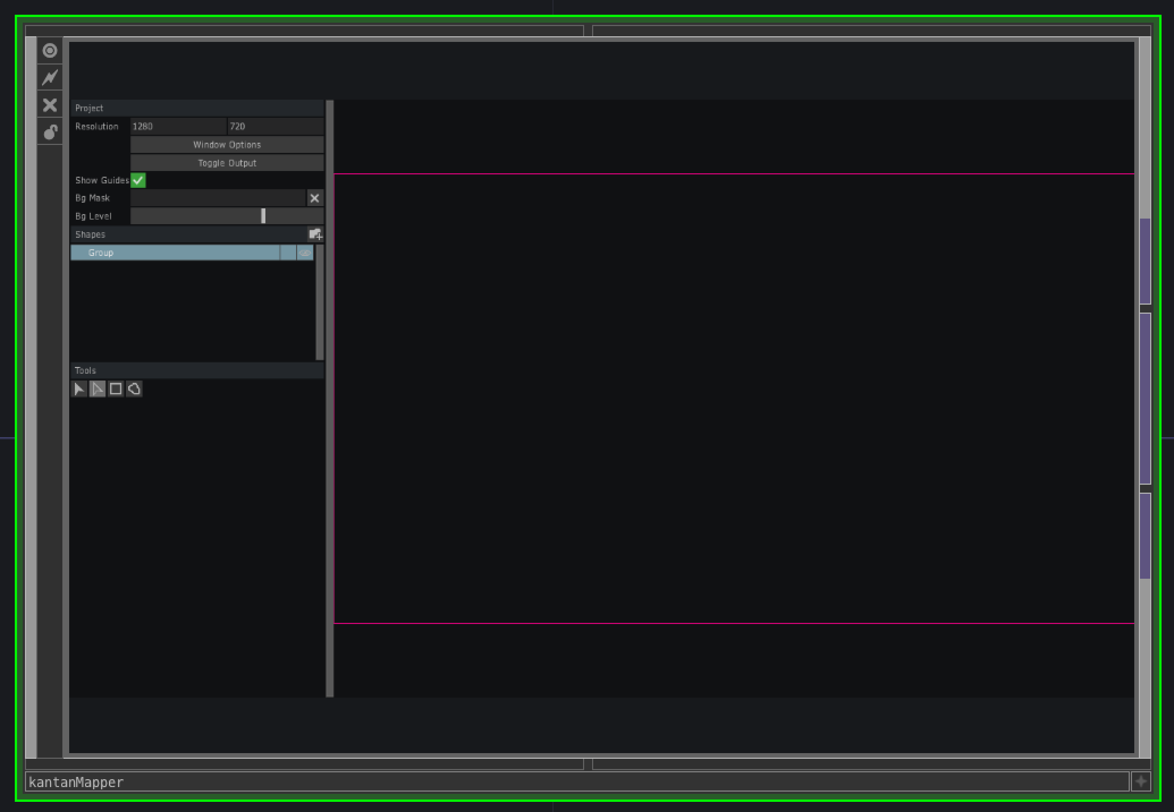
Getting the Kantan Mapper
Create a new component in the root component and call it “Kantan”
Kantan doesn’t work properly if you place it at the root level of your project
Go inside and drag in a KantanMapper component from the Palette Browser
It’s probably under the “Mapping” folder

Slide 11
Setting up Kantan with your projector
Under “Kantan” properties page, there are two buttons that open and close the Kantan Window
Open the Kantan Window!
Set “Always on Top” to “On”
Makes output always visible
If you have a projector:
Set resolution to that of your projector
Click on ”Window Options”
Set Monitor to 1 or 2 or ... depending on the index of your projector
If you don’t have a projector:
Set resolution to 640 x 480
Click on ”Window Options”
Set monitor to 0
Close Window Options
Click on “Toggle Output” – outputs Kantan window to projector or to the window on the screen

Slide 12
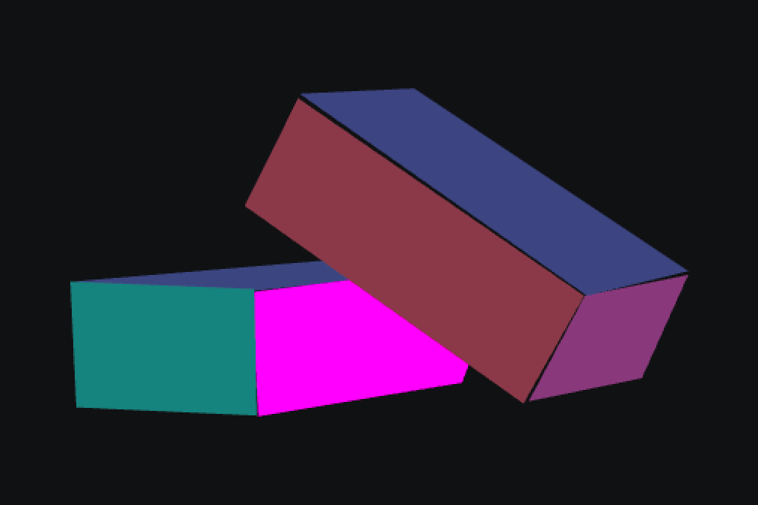
Quads
Create some quads and map them to the surfaces of your object
Note that when you move your cursor over the pink workspace in the Kantan Window, an orange cross-hair moves over your output
You can work either in the Kantan work panel or in the projector output
When creating a quad:
Click down to place the top left corner, drag to the bottom right corner and release
Move the bottom left and top right corners to their correct positions
By default, when you create a new quad, it is added to the list of Shapes
Shapes further down the list are on top of shapes above them in the list
You can move the shapes around in the list to change the order
Put shapes in a group so that you can manipulate them all together
e.g., if your object is moved and you have to move all the shapes slightly to the right or left

Slide 13
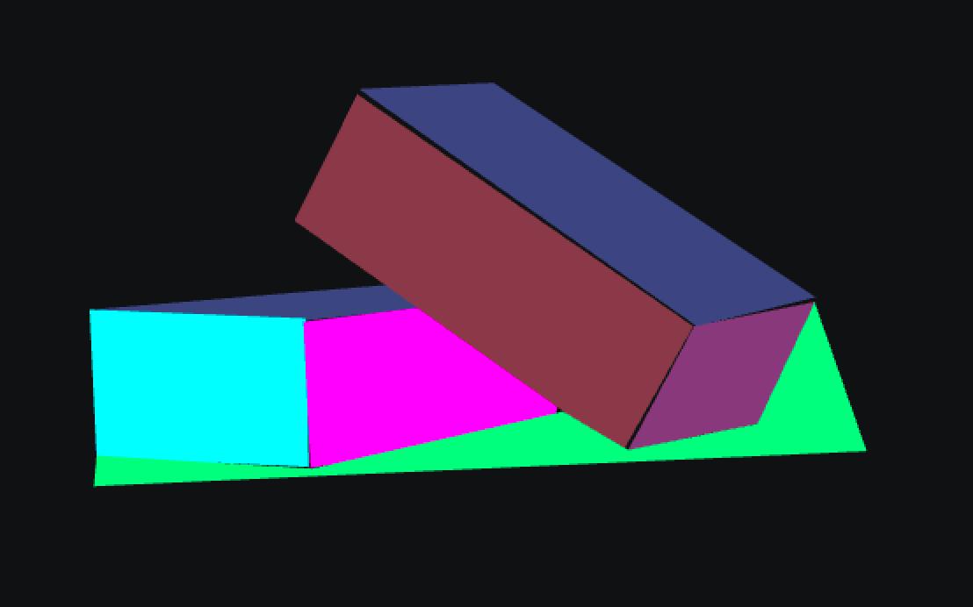
Freeform shapes
Use the freeform tool to create surfaces with more than 4 corners

Slide 14
Adding textures
Textures can be any TOP
You can create your own textures or you can import images and movies
Drag the source TOP to the “Texture” parameter for the desired shape
Remember to check the box to the right of the parameter box

Slide 15
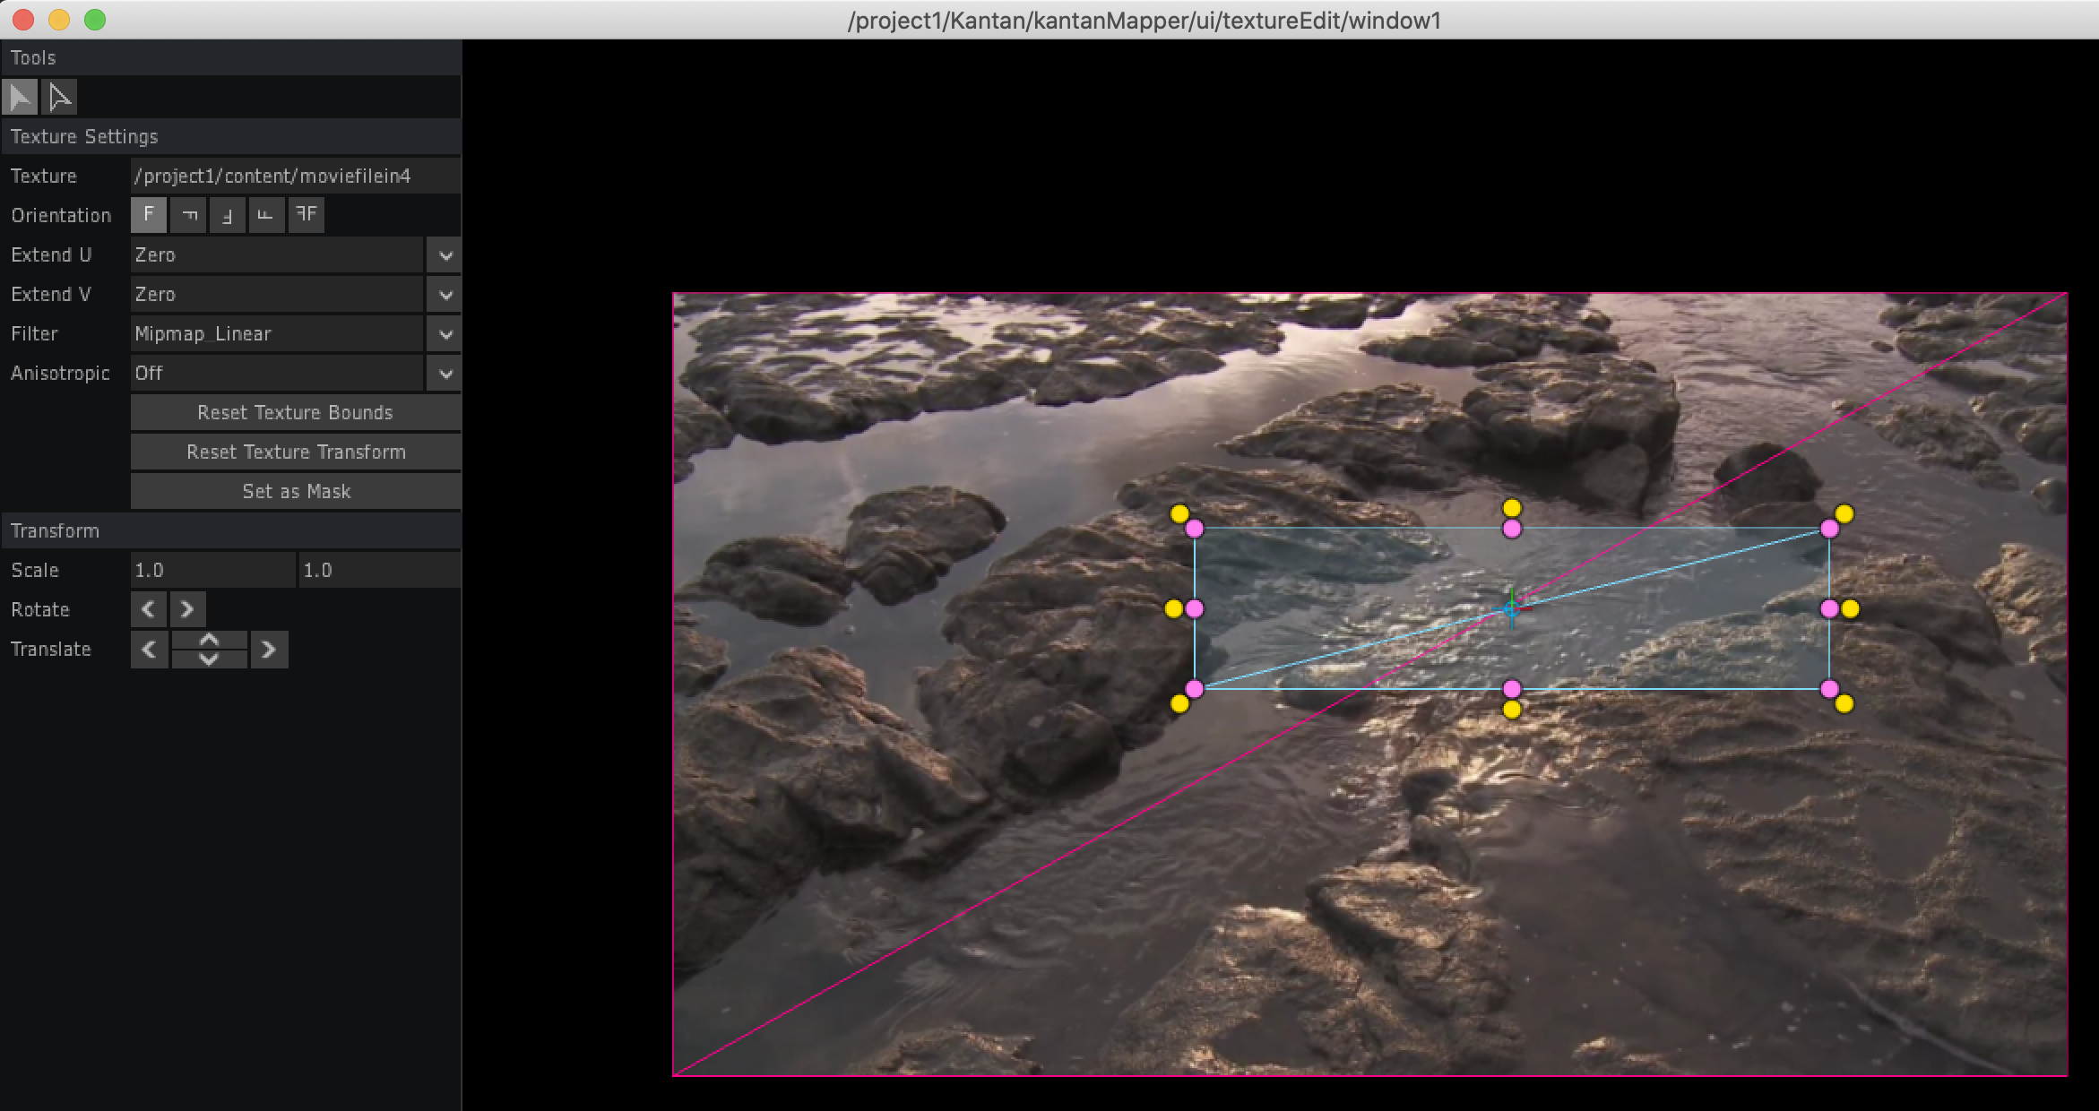
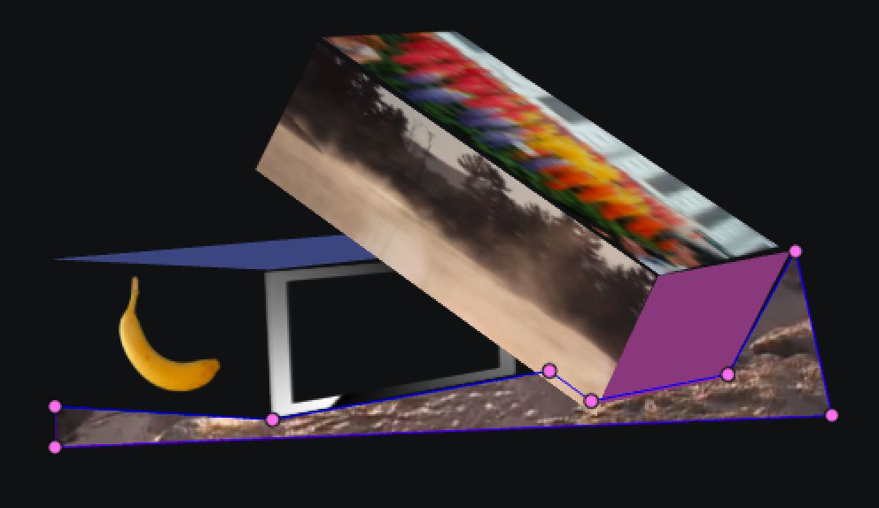
Editing textures
Press the “Edit Texture” button in the Kantan Window to edit the portion of the texture used in the mask
In the Edit Texture window, you can press the “Set as Mask” button to obtain a copy of the mask that you can move around in the texture
You can increase the amount of the texture included by increasing the Scale factor
You can also repeat textures and transform them

Slide 16
Intro to 3D Mapping
Create a 3d model (e.g., using Cinema4D)
UV unwrap it and export it as an FBX file
Drag the FBX file into TD
Drag a CamSchnappr COMP into your network
In CamSchnappr
Set “Show Wireframe” to ON
Set “Texture Alpha” to 1
Set “Output Monitor” to your Projector
Set the “Geo SOP” to the mesh SOP in the imported model
Click on “Open Output” to open the output window
Choose at least 6 well-spaced vertices and move them to their correct positions in the projected window

